Slide 1
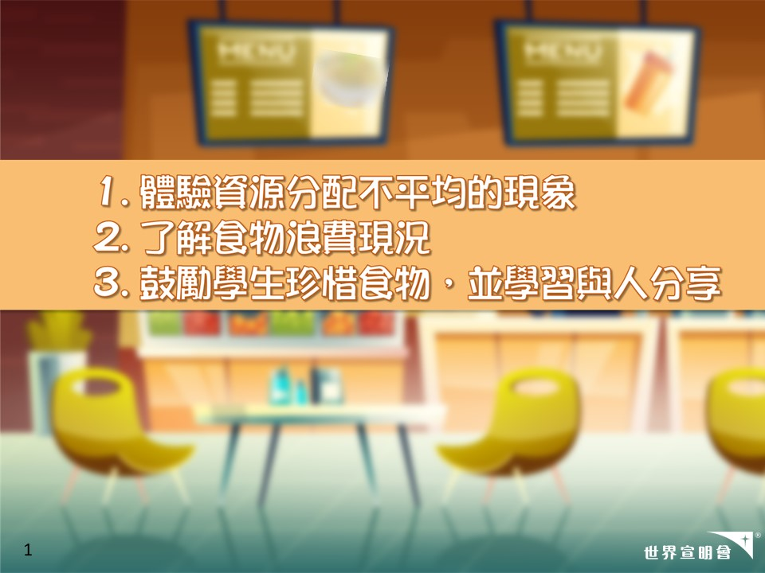

1
Notes:
活動目標

Slide 2
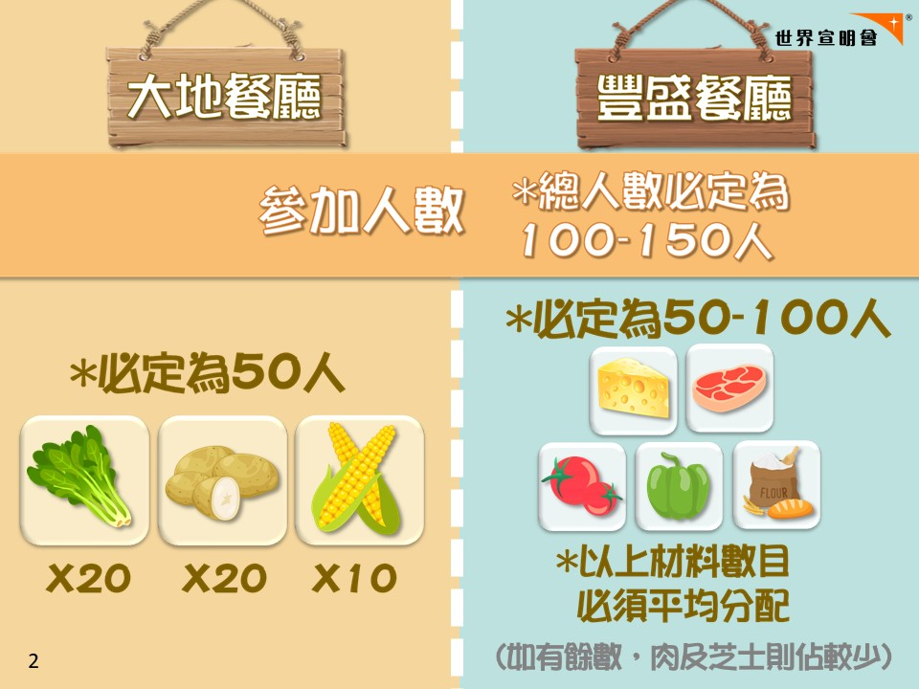
Notes:
[此頁為教師用]
-大地餐廳(黃卡)：固定50張 = 菜(20張) + 薯仔(20張) + 粟米(10張)
-豐盛餐廳(藍卡)：(總人數–50張) ÷ 5 = 肉/ 芝士/ 蕃茄/ 青椒/ 面粉 (如有餘數→肉及芝士則估較少)
---------------------------------------------------------------------------------------------------
*建議學生穿運動服

Slide 3
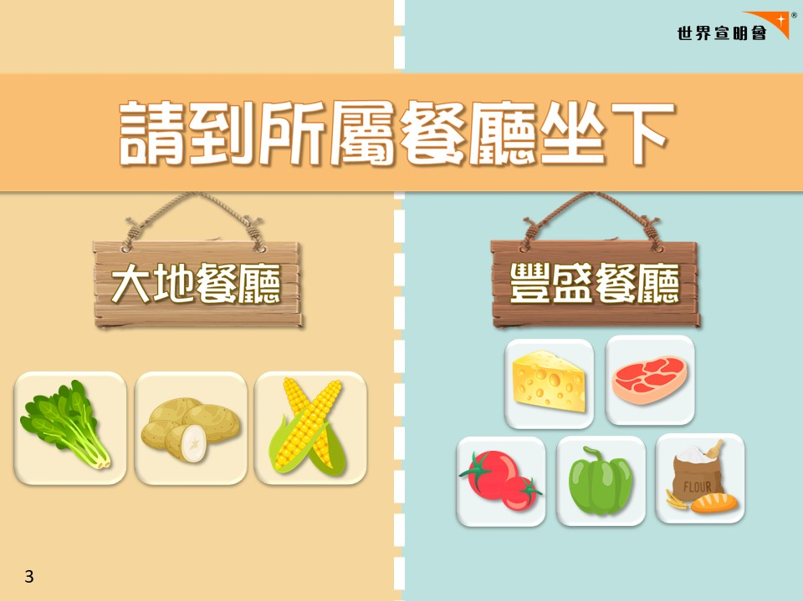
Notes:
[學生入禮堂時]
-請領取食物卡後，到自己所屬餐廳坐下

Slide 4

貧富一餐
Notes:
-我係今日遊戲主持
-今日會帶領大家參與貧富一餐活動，遊戲就叫做《誰是「煮」角》
-得到高分嘅話就有機會成為今日嘅主(煮)角，(可能有機會食富餐)

Slide 5
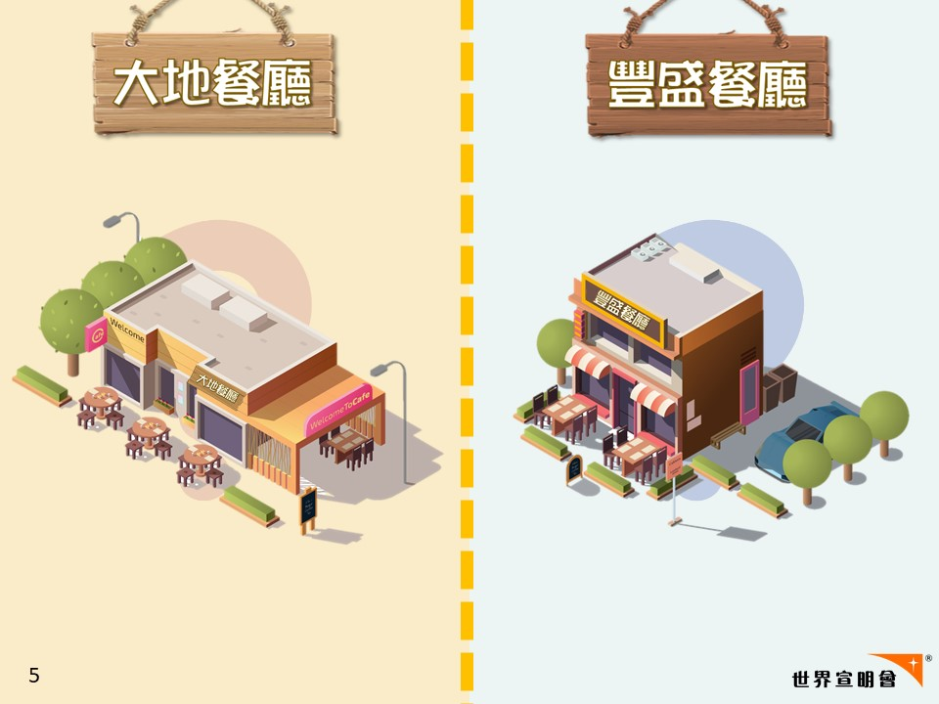
Notes:
-開始遊戲前，想先介紹下兩間餐廳。分別係左邊嘅「大地餐廳」同右邊嘅「豐盛餐廳」

Slide 6
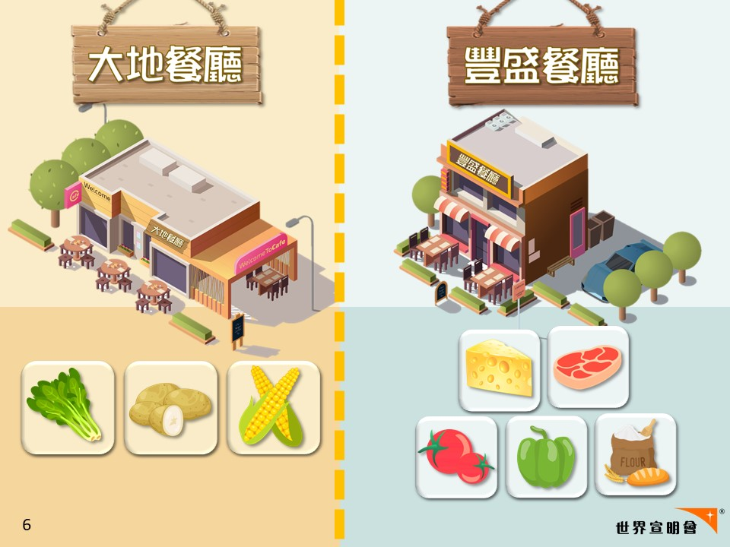
Notes:
-今日要派你地去依兩間餐廳幫手，你地要按客人嘅要求做餐
-黃卡只有3款食材，係大地餐廳嘅食材，請你到左邊大地餐廳坐下
-藍卡有5款食材，係屬於豐盛餐廳嘅食材，請你到右邊豐盛餐廳坐下

Slide 7


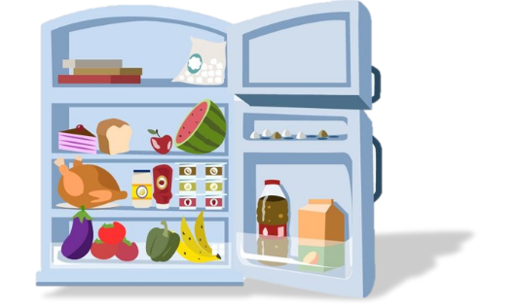
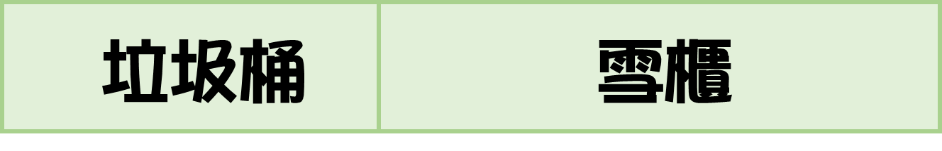


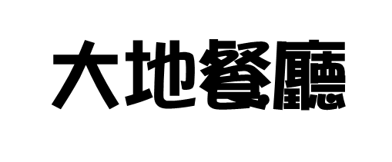

7
Notes:
[請選擇佈置方法：參照第7或第8頁]
-我地一齊認識下餐廳嘅唔同區域啦
-台下分別係兩間餐廳：左邊係大地餐廳，加邊係豐盛餐廳
-台上左邊係垃圾桶
-右邊係雪櫃
-你地會見倒有指示牌，同埋地下會有線將兩邊餐廳劃分

Slide 8

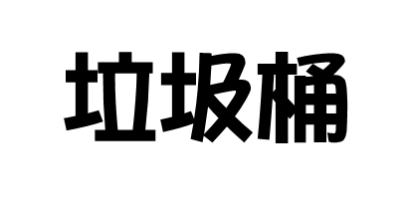



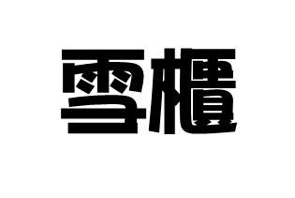
8
Notes:
[請選擇佈置方法：參照第7或第8頁]
-我地一齊認識下餐廳嘅唔同區域啦
-有兩間餐廳：最左邊係大地餐廳，中間係豐盛餐廳
-右邊前部分係垃圾桶
-右邊後部分係雪櫃
-你地會見倒有指示牌，同埋地下會有線將兩邊餐廳劃分

Slide 9
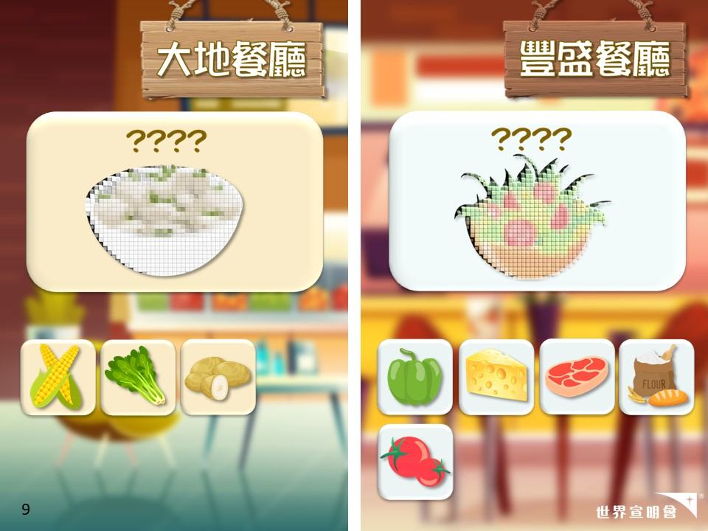
Notes:
-兩間餐廳將會營運4個回合
-每回合在螢幕上，會顯示兩間餐廳客人分別想食咩餐，同埋所需食材
-限時3分鐘內，根據所需食材，同其他食材組合成一份餐，做得愈多份餐愈好

Slide 10
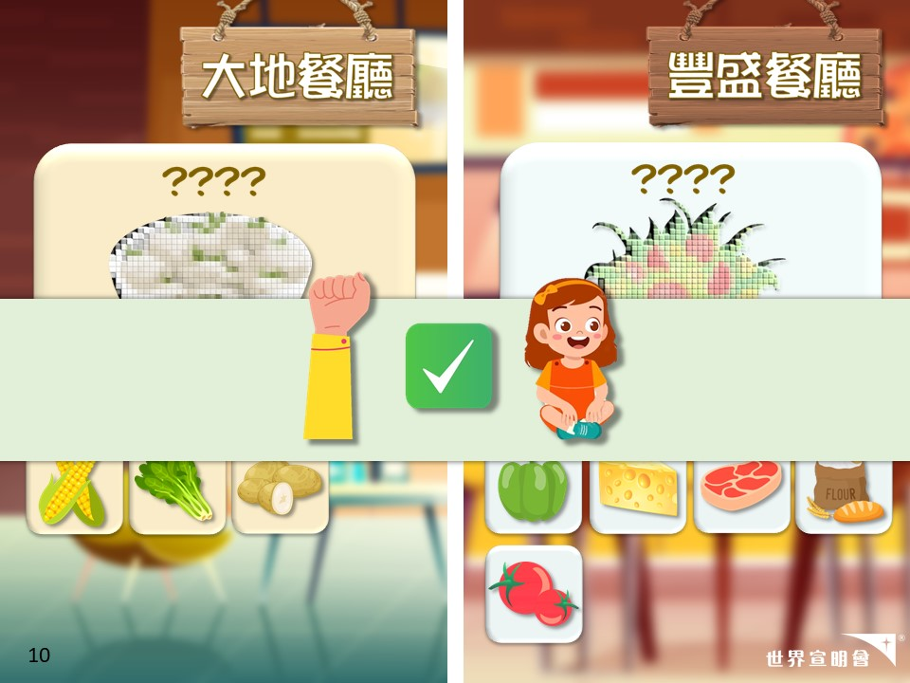
Notes:
-組合好就舉手比老師檢查，做得岩就請坐低

Slide 11
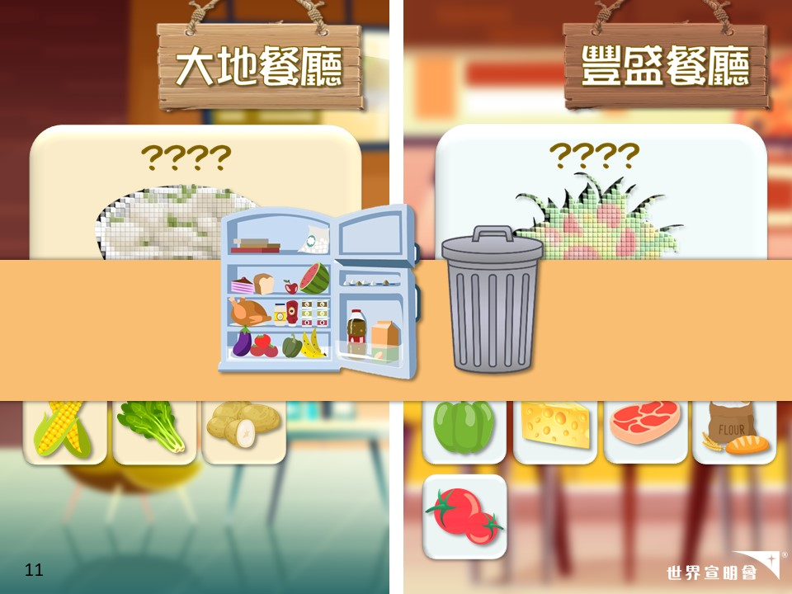
Notes:
-如未能組合，就留喺餐廳，老師會安排大家去雪櫃或垃圾桶
-入左雪櫃嘅食材：下回合可繼續遊戲
-入左垃圾桶嘅食材：未能參與隨後回合

Slide 12
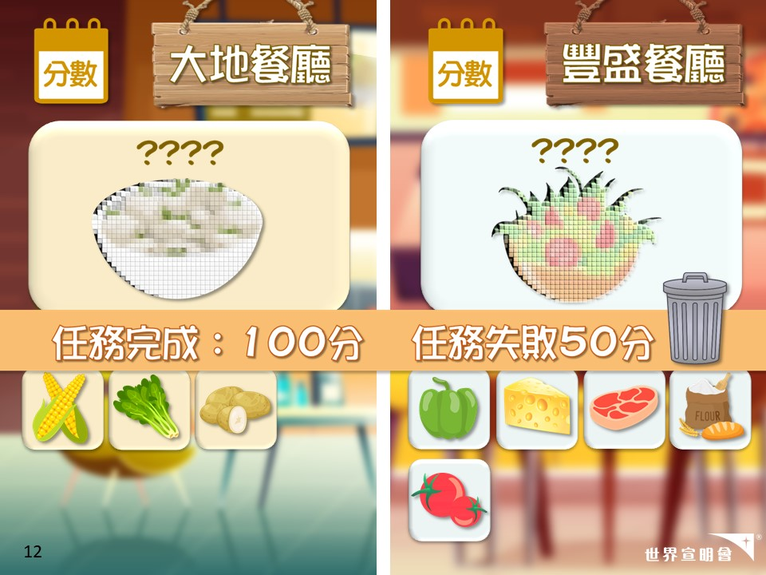
Notes:
-左上角會顯示每間餐廳嘅分數
-完成任務可得100分
-任務失敗或者有食物去左垃圾桶，只得50分

Slide 13
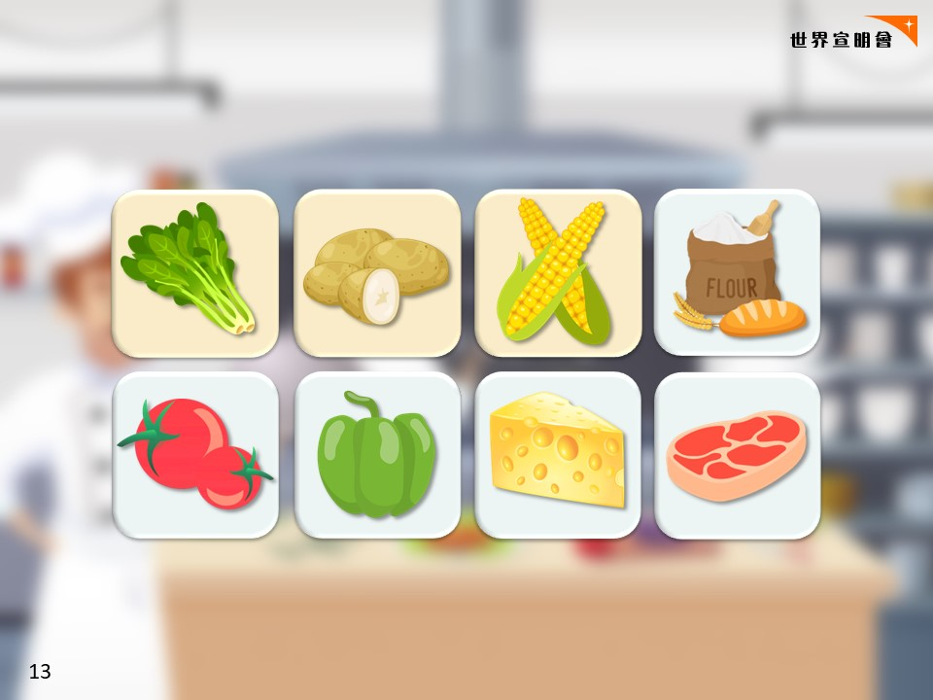
Notes:
-先請你地企起身
-你地頭先入禮堂每人係咪收倒一張食物卡？請你地依家望住你張食物卡
-數3聲之後你就會變身成果種食材

Slide 14
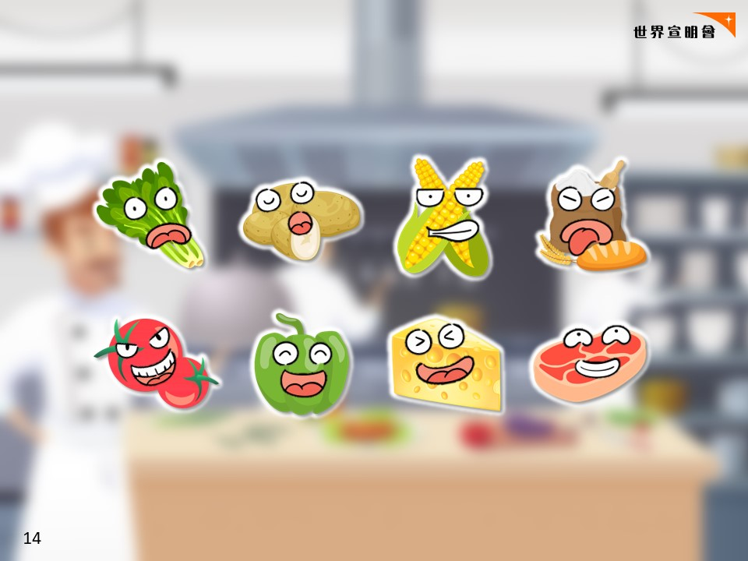
Notes:
-3...2…1… 由依刻開始，你地已經化身成你卡上嘅食材，我同老師就係餐廳嘅經理喇

Slide 15
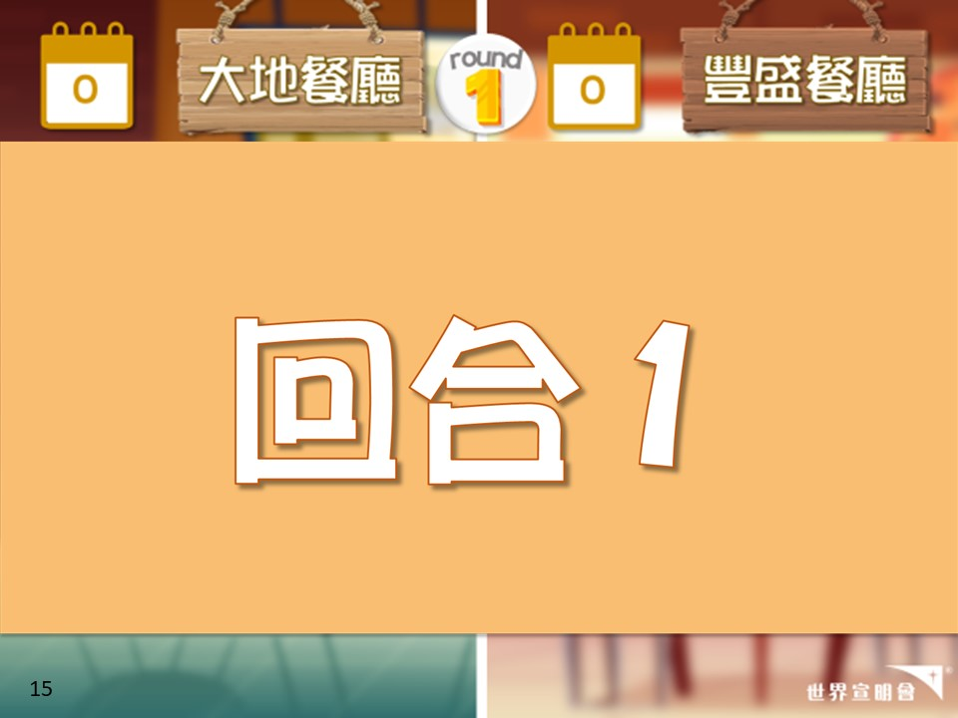
Notes:
[第1回合]
(計時3分鐘)

Slide 16
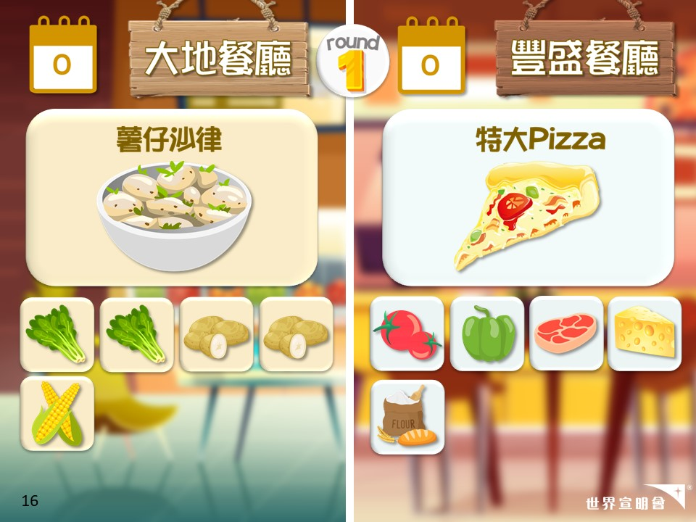
Notes:
[第1回合]
開始

Slide 17
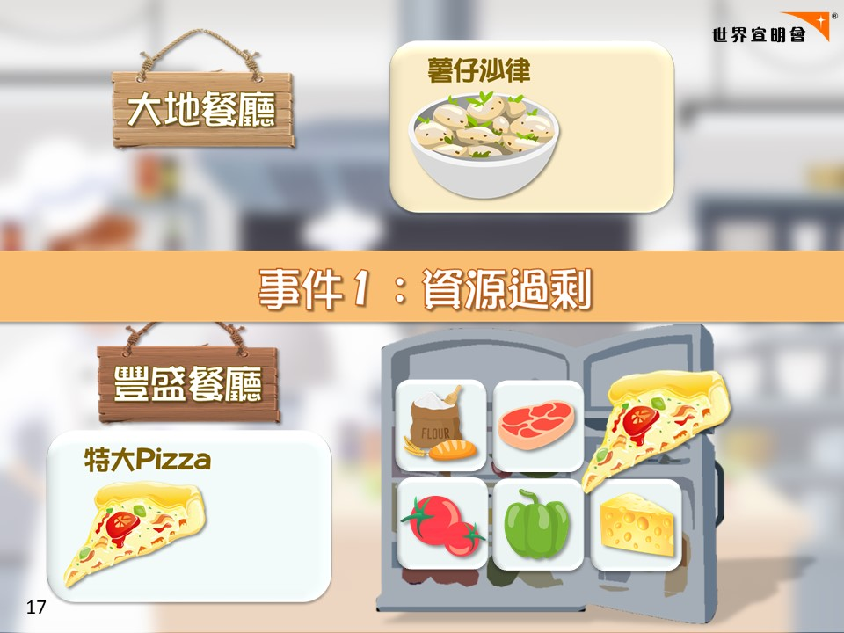
Notes:
[事件1：資源 過剩]
-豐盛餐廳有資源 過剩嘅問題
-依家想請豐盛餐廳企得最前嘅一組pizza企起身去雪櫃，你地係做多左嘅pizza
-同埋如果有企喺度分唔倒組嘅食材，請你地行上台去雪櫃，你地係多左嘅食材
-雪櫃嘅食材，你地今次好彩唔洗去垃圾桶。下回合我會指示你地落番台去幫手
-------------------------------------------------------------------------------------------------
Expected Result:
大地：食材完整分組
豐盛: 可能有食材未能分組

Slide 18
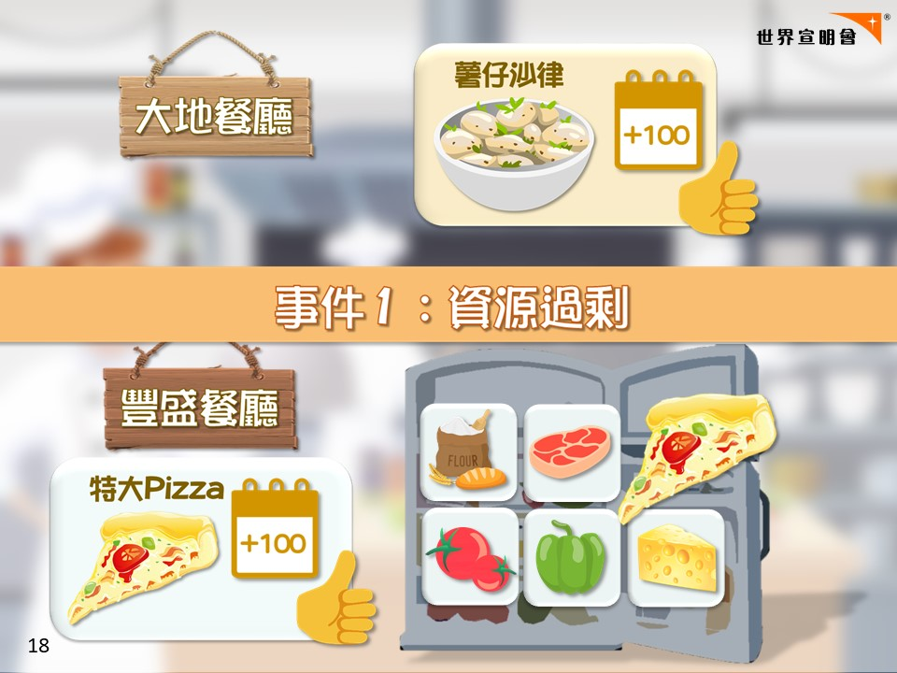
Notes:
[事件1：資源 過剩]
>>>分數<<<
-大地餐廳能夠完成任務；豐盛餐廳雖然做多左Pizza，但都完成任務。兩間餐廳各得100分
-------------------------------------------------------------------------------------------------
Expected Result:
大地：食材完整分組
豐盛：可能有食材未能分組

Slide 19
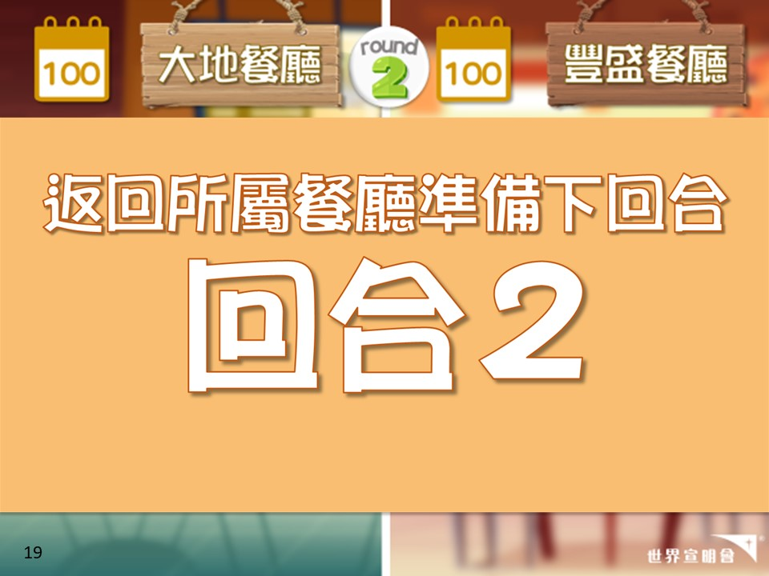
Notes:
[第2回合]
-請所有雪櫃食材，番去所屬餐廳準備第2回合

Slide 20
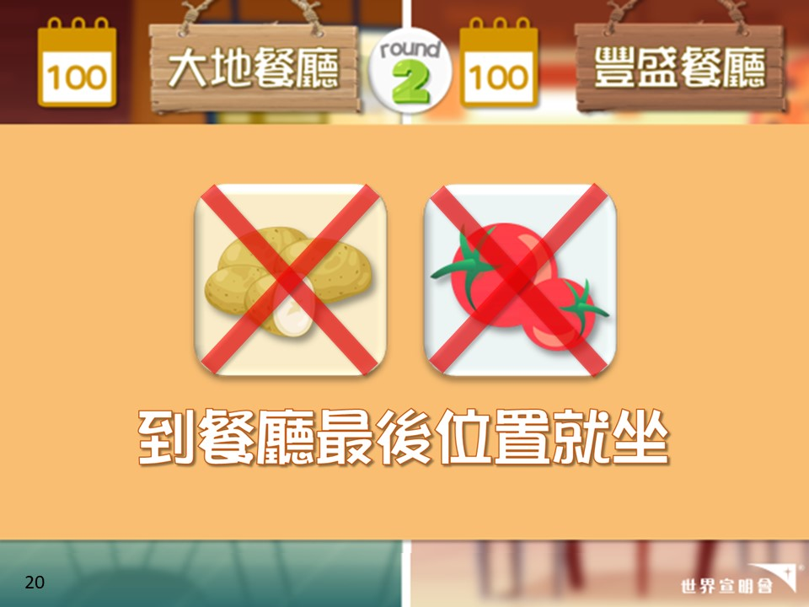
Notes:
[第2回合]
-今個回合有旱災發生，氣候太乾旱好耐冇落過雨，種唔倒蕃茄同薯仔
-請蕃茄同薯仔舉手，請你地到餐廳最後嘅位置就坐，今個回合你地就未能參與
-冇左蕃茄同薯仔都唔緊要，請大家盡力做餐
-(計時3分鐘)

Slide 21
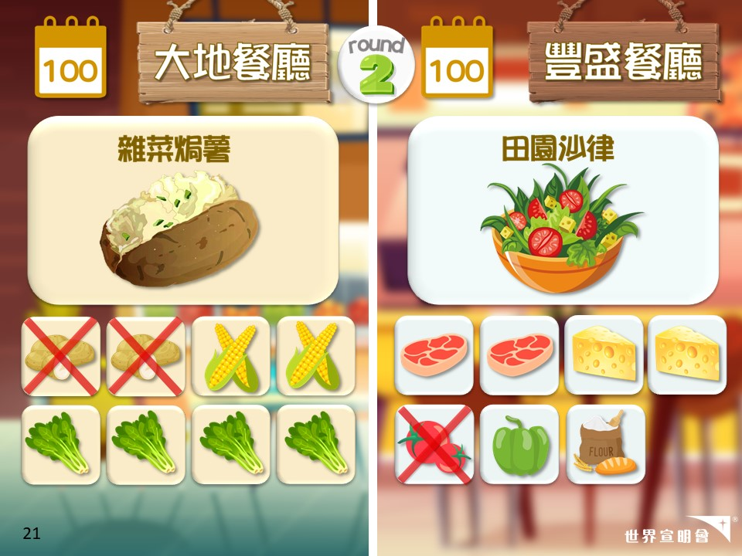
Notes:
[第2回合]
開始

Slide 22
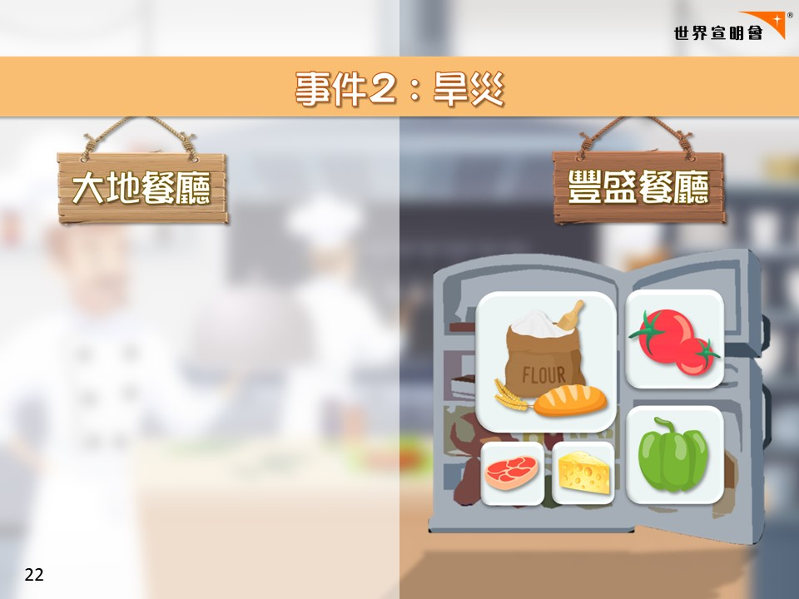
Notes:
[大事2：旱災發生]
-想先請企喺度分唔倒組嘅食材，請你地去雪櫃。你地就係淨左出黎嘅食材 ，今次都好彩唔洗去垃圾桶住，先放入雪櫃
-------------------------------------------------------------------------------------
Expected Result:
大地：有食材未能分組
豐盛：有食材未能分組

Slide 23
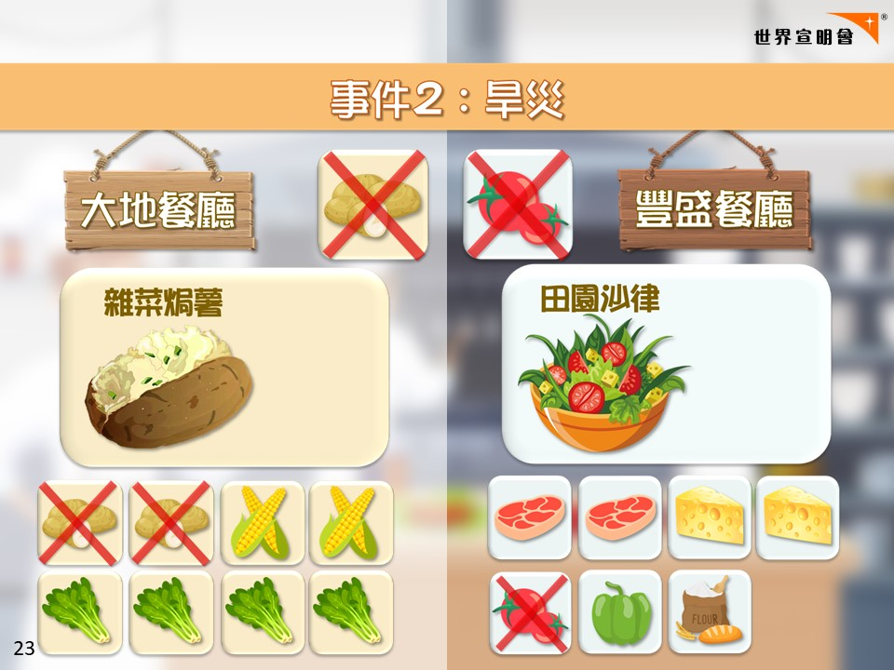
Notes:
[大事2：旱災發生]
-今個回合因為有旱災發生，種唔倒蕃茄同薯仔
-------------------------------------------------------------------------------------
Expected Result:
大地：有食材未能分組
豐盛：有食材未能分組

Slide 24
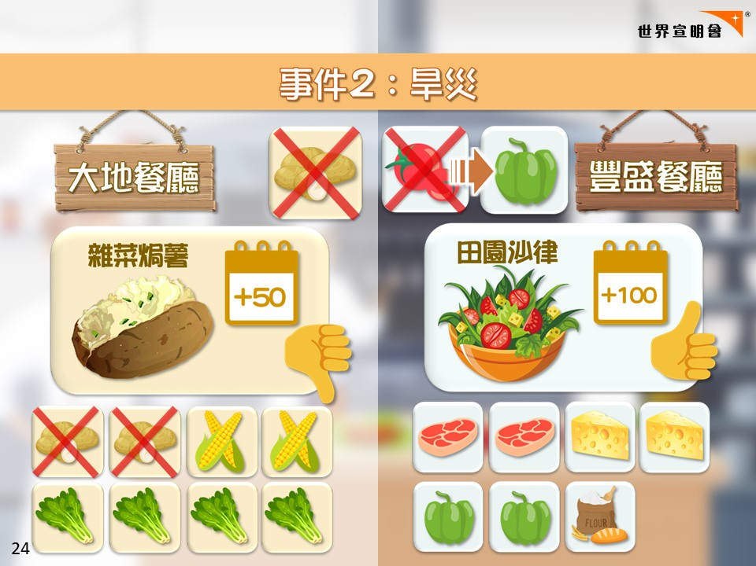
Notes:
[大事2：旱災發生]
>>>分數<<<
-大地餐廳冇晒薯仔，任務失敗，只得50分
-另外，旱災對豐盛餐廳冇咁大影響，冇左蕃茄仲可以用其他蔬菜--青椒代替。請豐盛餐廳嘅青椒舉手(部分在雪櫃裡)，你地可以代替蕃茄，豐盛餐廳完成任務，得100分
-------------------------------------------------------------------------------------
Expected Result:
大地：有食材未能分組
豐盛：有食材未能分組

Slide 25
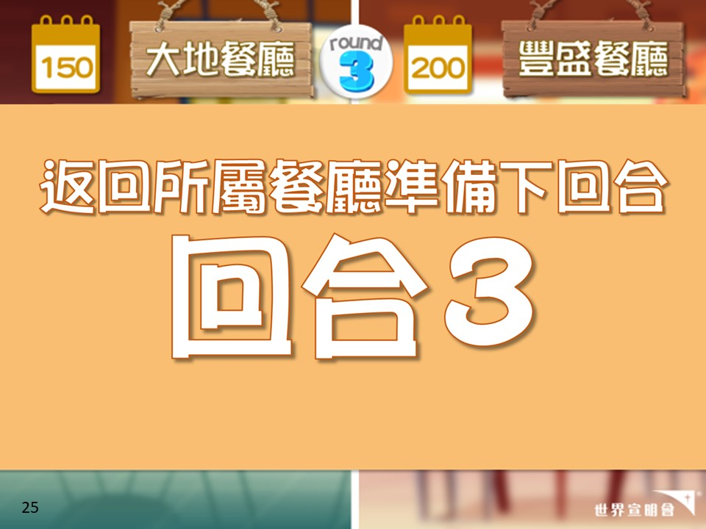
Notes:
[第3回合]
-請所有雪櫃食材及坐最後嘅蕃茄同薯仔，番去所屬餐廳，準備第3回合。
-旱災終於結束，黎到第3回
-(先計時2分鐘→隱藏菜單出現→計時1分鐘)

Slide 26
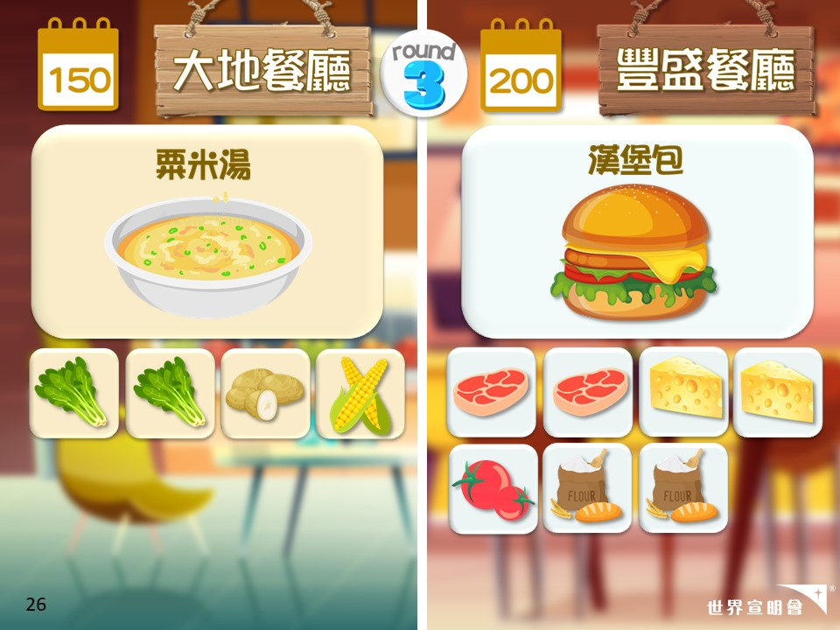
Notes:
[第3回合]
開始
(大約2分鐘後：出現隱藏菜單→請看下頁)

Slide 27
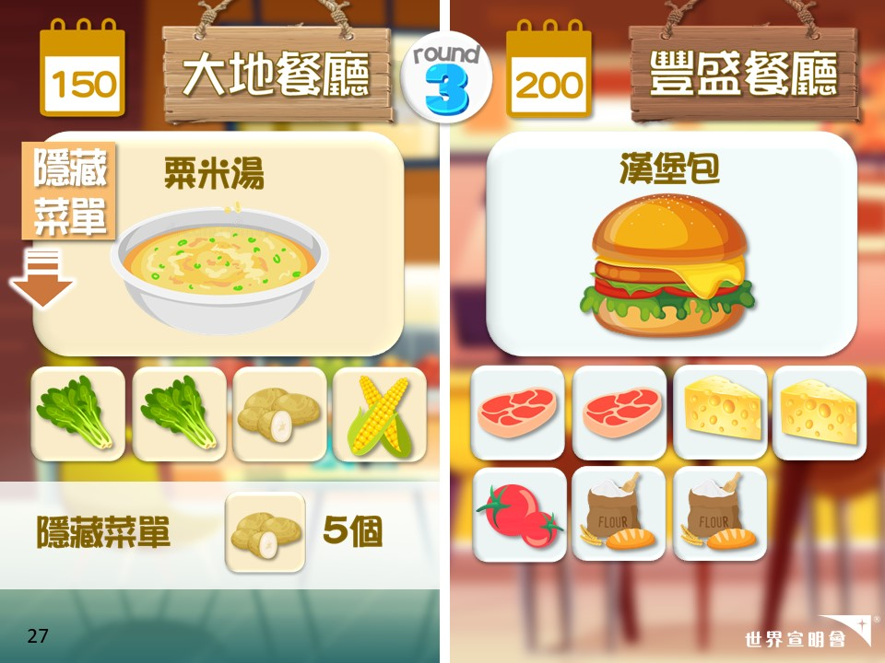
Notes:
[第3回合]
**(大約2分鐘後)
-大地餐廳嘅客人好肚餓，大家唔想浪費食物，出現左隱藏菜單！請淨番嘅薯仔5個1組出餐

Slide 28
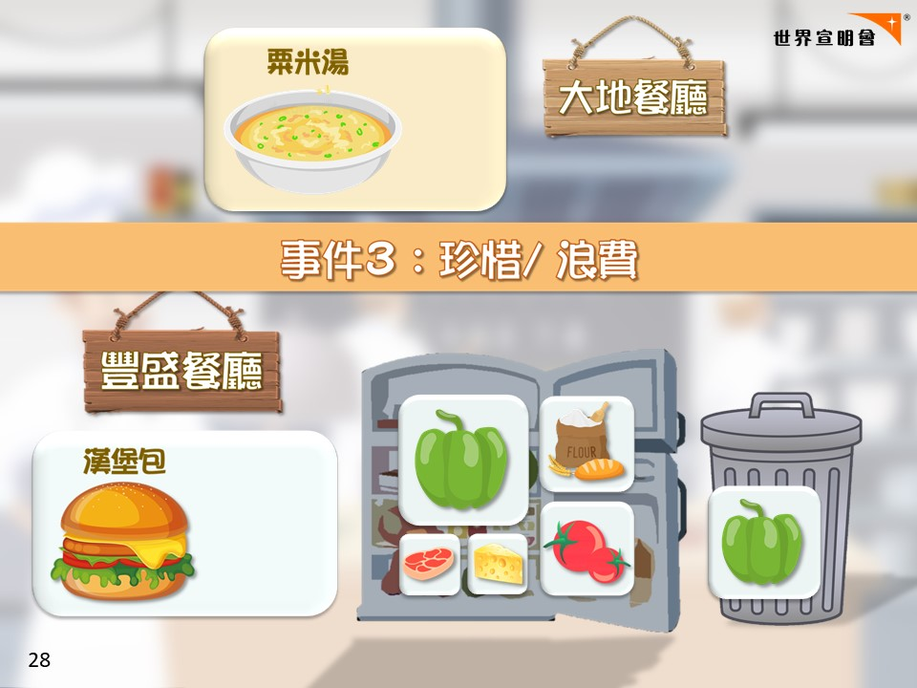
Notes:
[大事3：珍惜/ 浪費]
-豐盛餐廳有好多人偏食唔食青椒，請在場所有戴眼鏡嘅青椒(或有著外套/ 單數學號…) 到垃圾桶
-豐盛餐廳其餘企喺度分唔倒組嘅食材(部份青椒+部份蕃茄+少量其他食材)，請你地去雪櫃。你地就係淨左出黎嘅食材 ，今次好彩唔洗去垃圾桶住，下次未必咁好彩喇
------------------------------------------------------------------------------------------------
Expected Result:
大地：未有隱藏餐單前，部分薯仔未能分組；隱藏餐單出現後，能完整分組
豐盛：有食材未能分組；亦有部分青椒去了垃圾桶

Slide 29
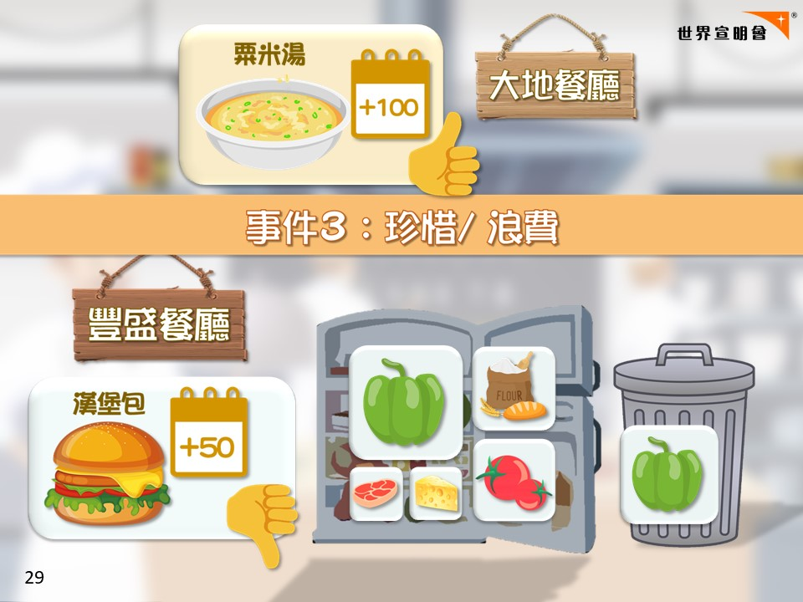
Notes:
[大事3：珍惜/ 浪費]
>>>分數<<<
-雖然大地餐廳一開始淨左好多薯仔，但佢地珍惜食物，仲冇浪費薯仔，最終能完成任務，得100分
-豐盛餐廳有食客偏食，將青椒倒左落垃圾桶，所以只得50分
-------------------------------------------------------------------------------------------------
Expected Result:
大地：未有隱藏餐單前，部分薯仔未能分組；隱藏餐單出現後，能完整分組
豐盛：有食材未能分組；亦有部分青椒去了垃圾桶

Slide 30
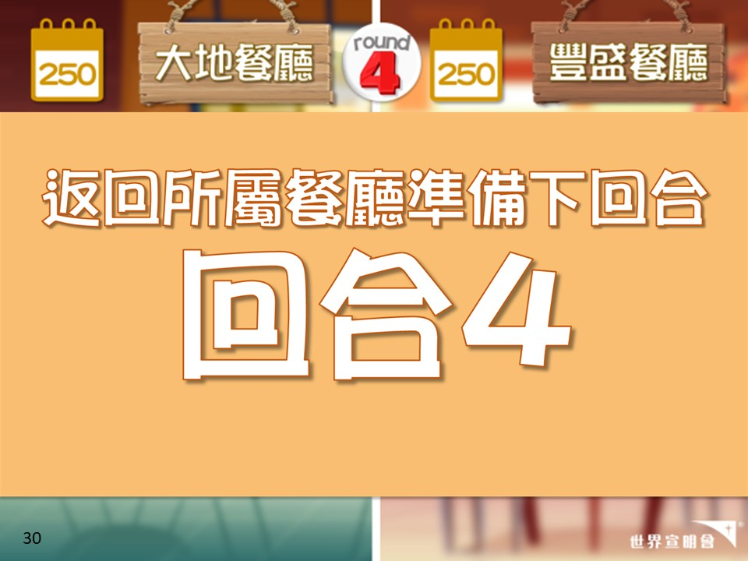
Notes:
[第4回合]
-請所有雪櫃食材，番去所屬餐廳，準備最後一個回合
-垃圾桶裡面嘅食材好抱歉你地唔可以參加最後依個回合，但都想你去耐心等候同埋觀察
-(先計時1分鐘→出現新任務→計時2分鐘)

Slide 31
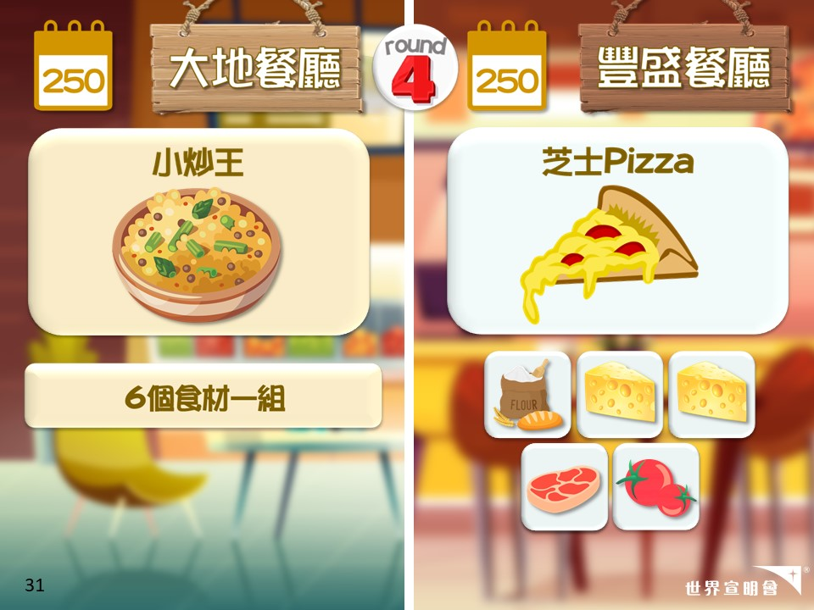
Notes:
[第4回合]
-開始
(大約1分鐘後：出現新任務→請看下頁)

Slide 32
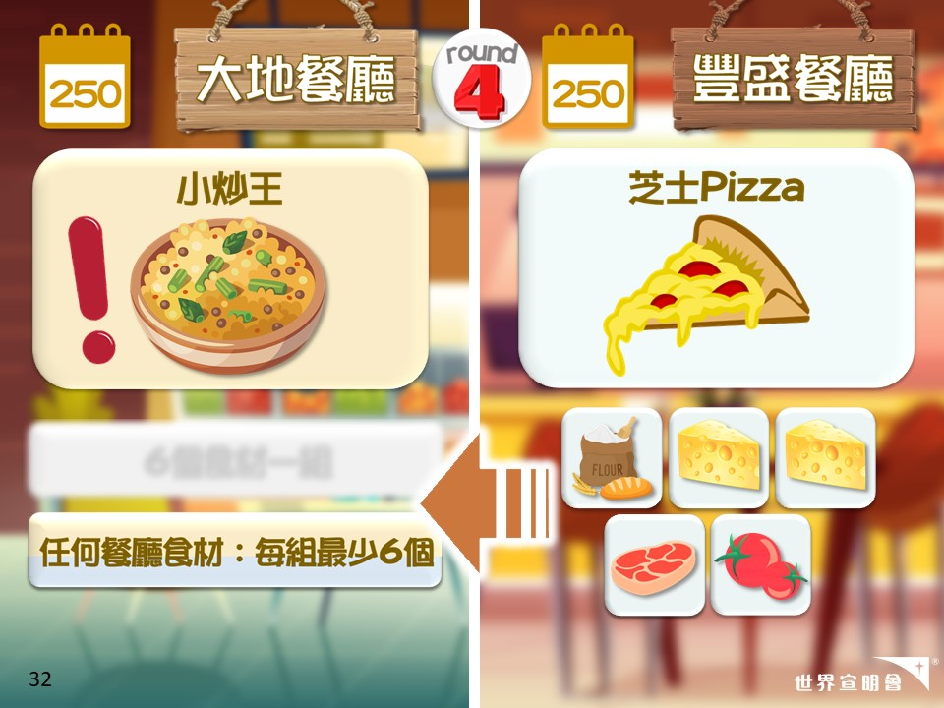
Notes:
[第4回合]
**(大約1分鐘後)
-聽講大地餐聽仲有好多好肚餓嘅人，但佢地唔夠食材；而豐盛餐廳仲有好多食材，請你地幫助大地餐廳
-大地餐廳任務即係改為：任何餐廳最少6個食材
-你地依家有2分鐘時間(如果唔肯分享，提示：再有浪費要去垃圾桶)

Slide 33
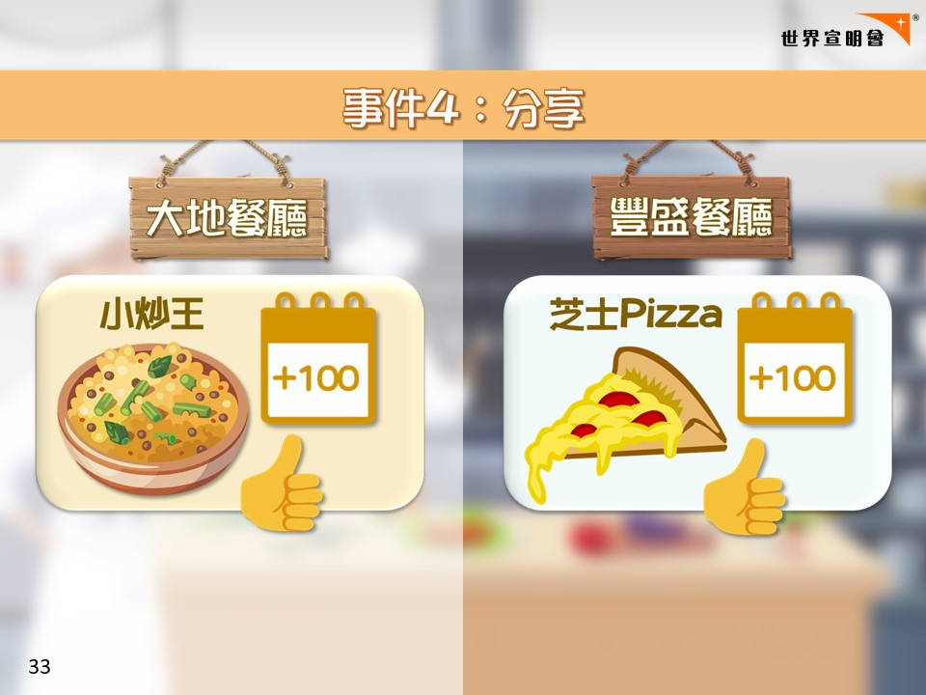
Notes:
[大事4：互相分享]
>>>分數<<<
-原本大地餐廳唔夠食材，多得豐盛餐廳嘅幫助，兩間餐廳都能夠完成任務，各得到100分
-如有未能分組同學：企喺度嘅同學，就係剩下食材。食材變壞喇，要倒入垃圾桶
--------------------------------------------------------------------------------------------
Expected Result:
大地：豐盛餐廳分享後，可完整分組
豐盛：分享後，可完整分組

Slide 34
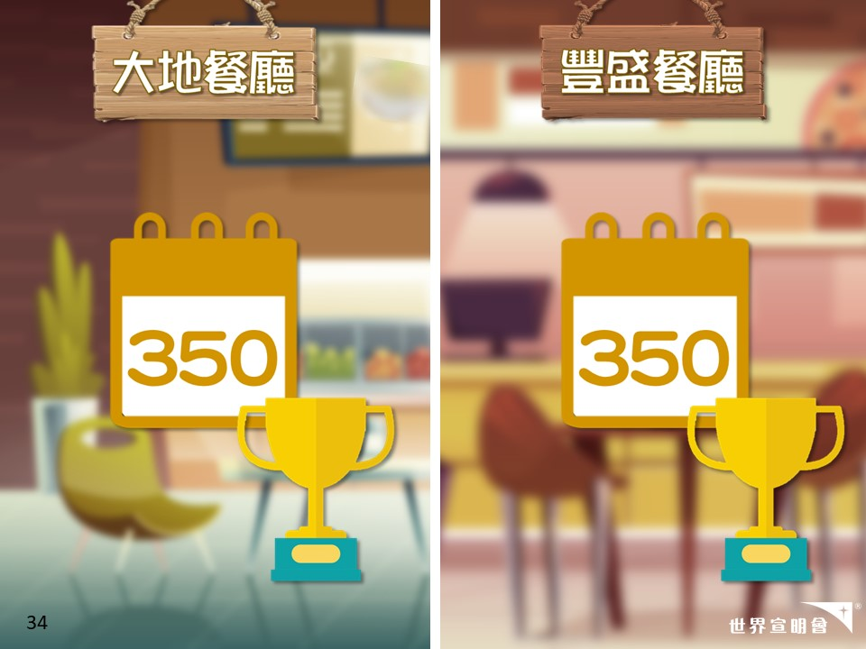
Notes:
-睇睇大家分數先，兩間餐廳同分，大家都做得好好

Slide 35
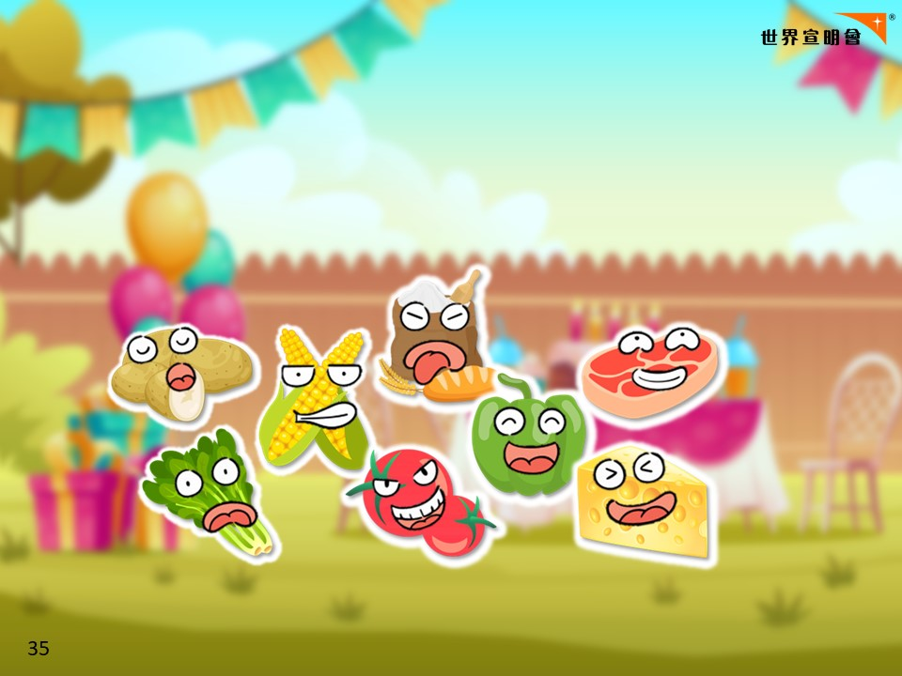
Notes:
-玩完遊戲，番番黎現實生活，我數3聲，你就唔再係餐廳裡面嘅食材。3…2…1…

Slide 36
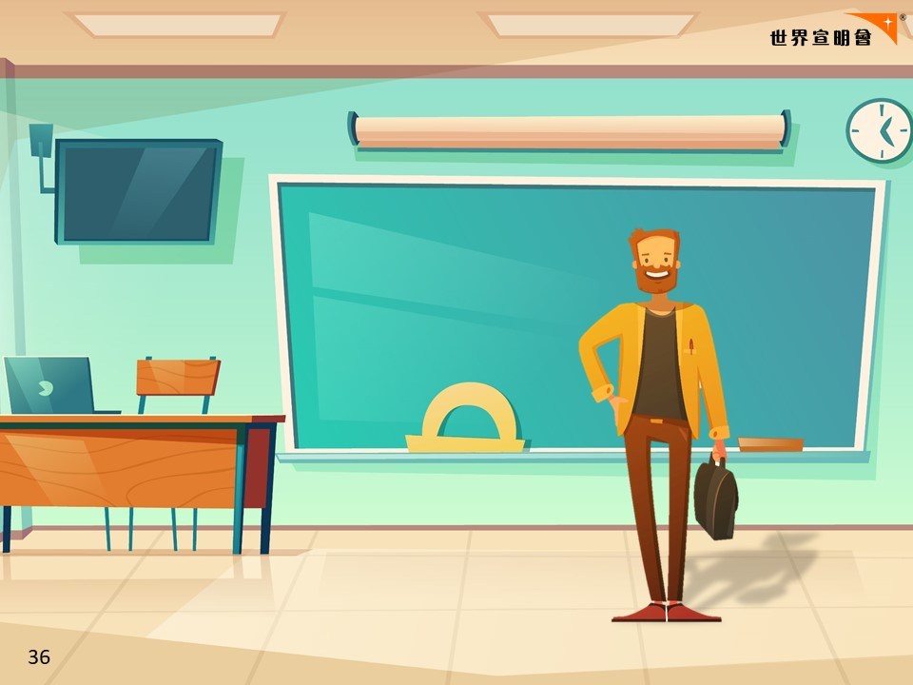
Notes:
-依家番番黎學校禮堂，你係一個香港嘅小學生
-有請餐廳老闆選出今日(可以食富餐)嘅煮角啦

Slide 37
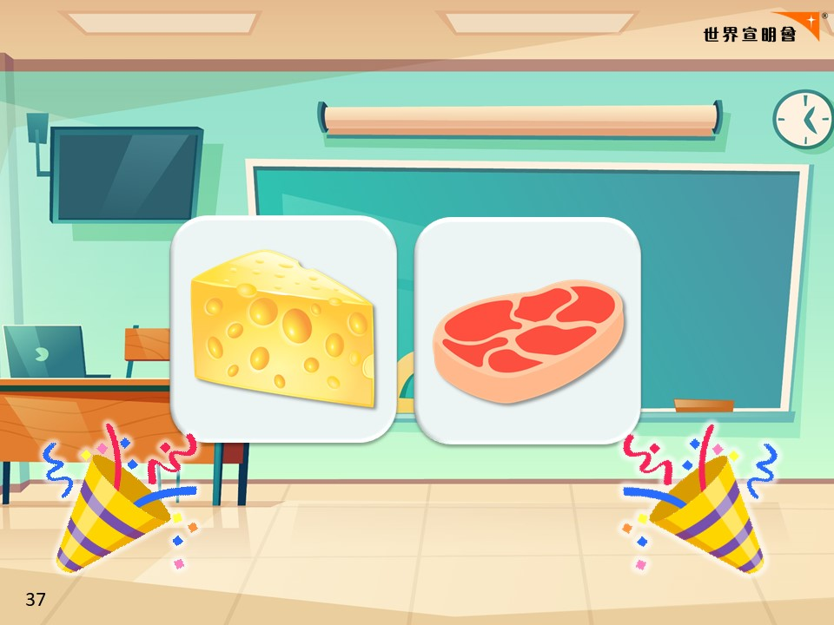
Notes:
[冇貧富宴]
-今日嘅煮角係…肉同埋芝士
-老闆話其實每種食材都好重要好有營養。佢揀肉同芝士，係因為肉同芝士有豐富蛋白質，而喺資源不足嘅地方，佢地嘅食物都係缺乏蛋白質，所以就揀肉同芝士
----------------------------------------------------------------------------
[有貧富宴]
-今日嘅煮角係…肉同埋芝士
-你地可以食富餐，請你地帶同遊戲卡出黎拎食物
-其餘同學就會食貧餐，你地都唔洗擔心，你地有面包食嘅(老師派面包)
-老闆話其實每種食材都好重要好有營養。佢揀肉同芝士，係因為肉同芝士有豐富蛋白質，而喺資源不足嘅地方，佢地嘅食物都係缺乏蛋白質，所以就揀肉同芝士
-(洗手)(祈禱)

Slide 38

Notes:
[實踐分享]
我希望大家可以實踐分享，好似頭先遊戲咁，睇見其他人資源不足嘅時候，(好似E+食貧餐嘅同學)你都會主動去同佢地分享
*留意學生秩序，勿讓貧餐同學亂搶富餐同學食物

Slide 39
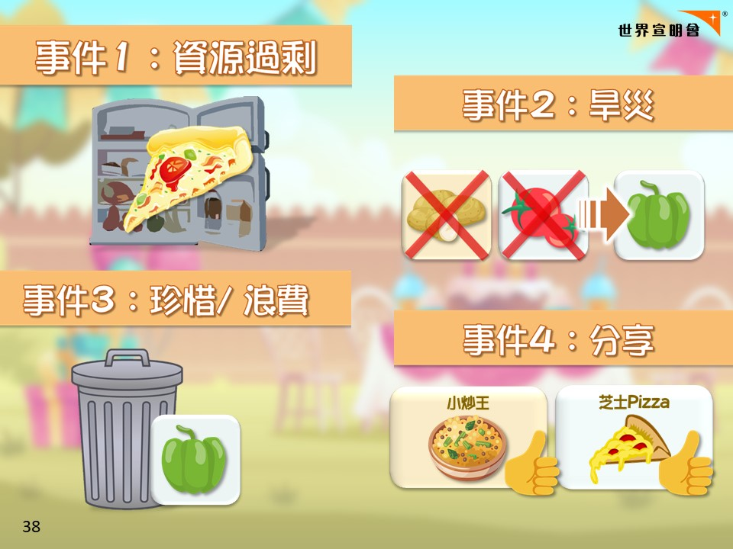
Notes:
[事件重溫]
事件1：豐盛餐廳有資源 過剩嘅問題，做多左pizza
事件2：旱災發生，大地餐廳食材種類少，冇薯仔又冇野可以化替薯仔；豐盛餐廳冇蕃茄，但搵倒其他蔬菜(青椒)代替
事件3：大地餐廳珍惜食物，出現隱藏餐單，用盡每1個食材；豐盛餐廳有人偏食，掉青椒落垃圾桶
事件4：大地餐廳唔夠食材，豐盛餐廳願意同佢地分享

Slide 40
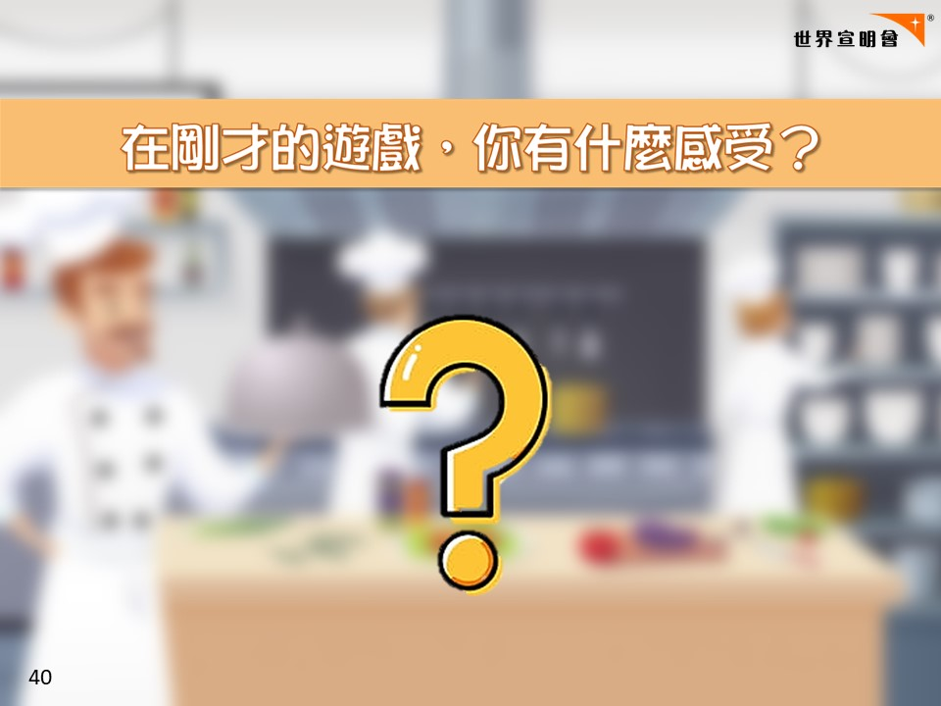
Notes:
[建議問題]
-如果我話兩間餐廳都代表一些國家/城市，會係點嘅國家？你又覺得香港係邊間餐廳？點解？
-當宣佈肉及芝士係主角，你有咩感受？(唔公平？這亦反映現實！貧窮人都好努力)
-旱災時，大地餐廳冇薯仔未能完成任務，你有什麼感受？(嬲？貧窮人努力卻得唔倒回報，冇選擇冇替代品)
-有冇人去過雪櫃/垃圾桶？你有咩感受？
→反思飲食習慣(浪費)：你有冇偏食？會否食淨野？你平時會點處理？依家呢？(鼓勵珍惜/分享)
-最後一個回合你地有分享嗎？生活中有幫過人嗎？幫倒人有咩感受？
-----------------------------------------------------------------------------------------------
[如有貧富餐]
-知唔知點解只有少部份人食富餐？
-食貧餐有咩感受？(唔抵？好嬲？對於貧窮嘅小朋友已經係非常豐富)
-食富餐有咩感愛？(好多富有人都冇反思，天天大魚大肉又浪費食物)
-食前望下食物，反思自己平時飲食習慣：浪費？偏食？
-----------------------------------------------------------------------------------------------
*可邀請作挑戰：eg. 今日唔食tea/ snacks
-----------------------------------------------------------------------------------------------
[additional questions]
-如果每日都好似大地餐廳一樣食同樣嘅食物，你有咩感受？
-旱災令食材短缺，未能完成任務，你有什麼感受？
-當你知道好多食物掉落垃圾桶有咩感受？
-兩間餐廳食物營養足夠嗎？

Slide 41
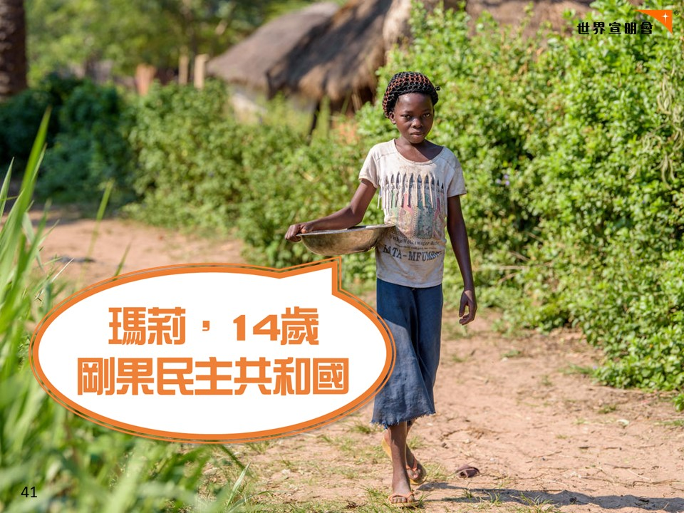
Notes:
-我地一齊睇下1條短片，係14歲瑪莉嘅故事，佢住喺非洲嘅剛果
-喺片段裡面我想請大家幫我數下，有幾多人一齊食果D食物，我之後會再問番你地架
---------------------------------------------------------------------------------------------
**WV250186 [食物短缺/ 食材單一]
Marie Ngalula, 14, (crocheted head covering, white top and blue skirt) cooks a meal of potato greens from their garden, without salt or oil, for their only meal of the day.- until a neighbor gives them a few drops of oil to add. She and her siblings eat together from one little bowl. Then a neighbor comes and shares a little fufu (manioc and maize ) with them.
Hunger:
Marie’s family is desperately hungry in the days we visit them. Because her mother is sick and his father spends his days tending to her in the clinic, there is no money for food. Because there isn’t any cassava flour and cornmeal to make fufu, a bread-like dish that’s a Congolese staple, Marie and her siblings pick potato leaves from the garden. Marie sharpens a knife on a rock and uses it to chop the leaves into small pieces. She holds a bunch tightly in her left hand and runs the knife through them. Her cousin, also named Marie Ngalula, pulls some wood from a pile and arranges it between three rocks that will hold the pot. She yanks some thatch from the roof and uses it for kindling. Because they also have no oil or salt, the recipe is uncomplicated. The greens are stuck in a pot of water and boiled until they become soft. They look very much like spinach. As luck would have it, a kind neighbor sends a few drops of oil which Marie mixes with the water. Her grandfather sends a little fufu, a huge treat for the 6 nearly empty bellies that share the small pot of greens. Later Marie will tell her mother during a visit to the clinic, “We’ve gone three days without eating anything but potato leaves. We have to endure the hunger. The hunger never kills someone.” Unfortunately, she’s wrong. Marie and her siblings also go to the CFS where, thanks to a newly introduced feeding program gives them each a bowl of porridge made from soy, maize, peanuts, maringa and sugar.
-----------------------------------------------------------------------------------------------------------------
Marie lives with her father, Alexandre Tshimanga, her mother, Ntumba Kalombo Antoinette and her brothers and sisters: 1-Kena Tshimanga, 12 2-Kankonde Moise, 10 3-Munamba Angel, 8 4-Musungayi Andre, 6 5-Mubuyi Tshimanga, 4 Marie lives in a small village outside of Kananga, Democratic Republic of Congo, DRC, called Tubuluku, which means antelopes (plural). Her house is a two-room hut with a thatched roof. Handful of wooden chairs are the only furniture. She lives here with an extended family of 13. Home Life Marie is a bright girl but there is a sadness in her eyes. Marie’s mother is in the nearby health clinic with a staph infection that has caused a huge abscess on her right side. It has become very serious. As a result, Marie has assumed many of the household duties. She’s forced, at 14, to assume the duties of an adult. Besides cooking for her brothers and sisters, she sweeps up the husks from palm nuts she crushes. She saves the husks to use as kindling for the fire. Marie and her siblings all sleep together in one room, huddled together for warmth and cover by an old and torn mosquito net. School Marie’s father laments his inability to send her back to school. “Marie is intelligent,” he says. “She could help me very much someday. I’d like to send her back to school but I can’t afford it. I’d like if she could further her studies even as far as university so that she can help me take care of her brothers and sisters someday.” Marie and her friends often play on the grass in front of the school they can’t afford to go to. Economic Development Marie’s father makes and sells charcoal to earn money for the family. He gets about 6,000 Congolese francs p/bag and can do about I per week. It’s not enough to support the family so Marie helps by selling palm nuts. Marie sits on the ground next to a pie of palm nuts she’s collected. She places one on a rock and pounds it with another rock separating the woody husk from the soft nut inside. When she has enough she’ll take them to sell. The buyer will have them mashed and pressed into oil for cooking. Marie walks the main road in front of the airport with her bowl of nuts. She squats in front of a local market, just across from the main gate. A woman with a small, green bucket stops. Money changes hands and Marie fill the woman’s bucket about halfway. It’s all the nuts she has today. Marie gets 800 francs for the transaction. That’s about 50 cents. She needs about a thousand francs to buy enough cassava flour to last the family for two days. Water Marie walks about a half mile down a steep, narrow embankment to a capped spring that provides the community water. She carries a cast iron pot on her head. When the pot is full she climbs the smooth, hardened clay of the path that leads home. She does this several times a day often with a friend or a cousin. Health Marie used to go to the health clinic when she got sick but since there isn’t any money now she is usually treated with some traditional medicine made from the leaves of local trees. Now she goes to the clinic almost daily but only to visit her mother. Antoinette, Marie’s mother sits on a straw mat in a nearly empty room at the clinic. A small bamboo cot off to one side is about 6 inches off the floor. She does not look well. Marie sits next to her and they talk. “I don’t know if I’ll be here to help you grow up,” Marie’s mom says. “Pray that God heals me.” The nurse tells me later that she is being treated with antibiotics and that her chances of recovery are good. Play This is where Marie looks most happy and alive! There are lots of children in Tubuluku. About 40 of them gather on the grass of the school across from Marie’s house. Marie leads the singing as the kids hold hands, move in a circle and sing loudly. Sometimes they all collapse into a fit of giggling. For the first time since we’ve met her, Marie smiles widely. She sings. She dances. For a time at least, she can be a kid again. Worship Like many people here, Marie is Catholic. She says that when she has clean clothes, she goes to church at St. Celestin right here in Tubuluku. She loves to sing and sings us a little song from church. “Glory of the saints who dwell in heaven. Everyone must bow down to you. We owe to God everything we have because all things come from Him.”

Slide 42
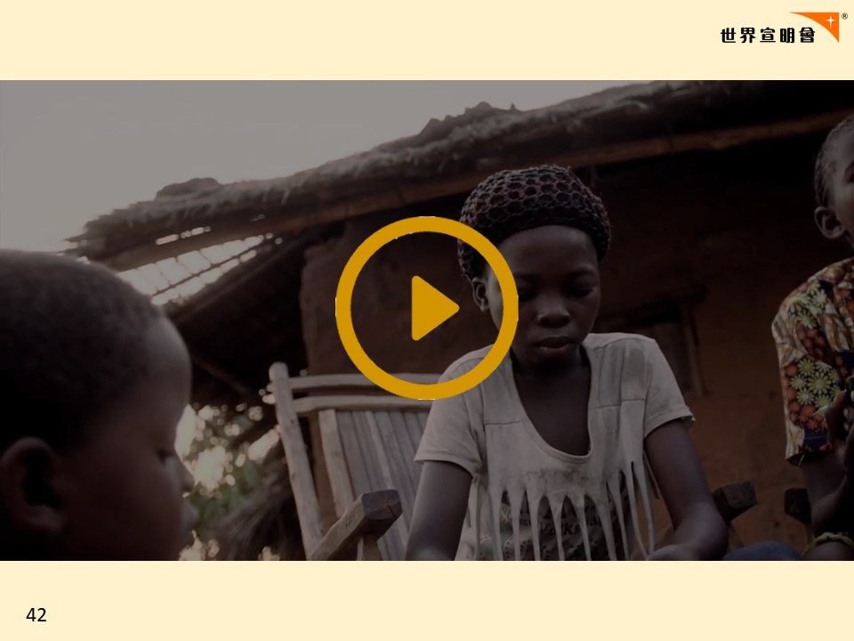
Notes:
只吃蕃薯葉的瑪莉 (2’02’’)
https://youtu.be/CN6K2jxO5nw

Slide 43
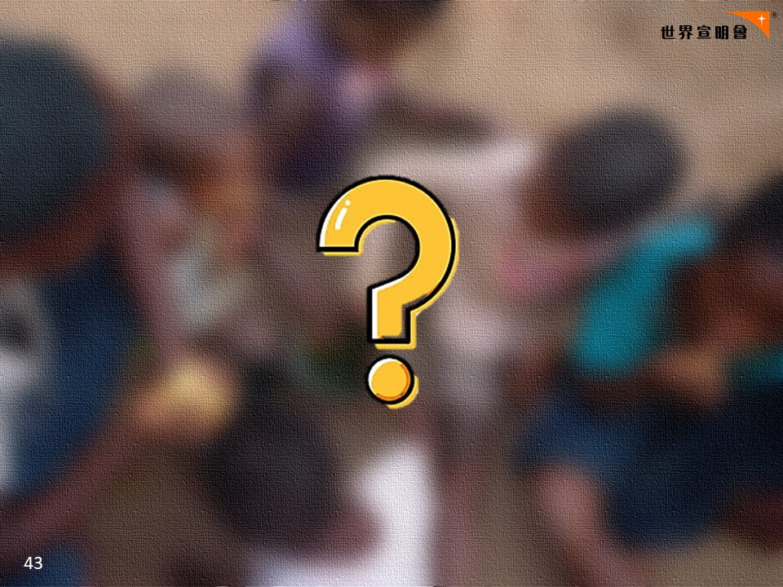
Notes:
-有冇人數倒影片中究竟有幾多人一齊去分享依盆食物？

Slide 44
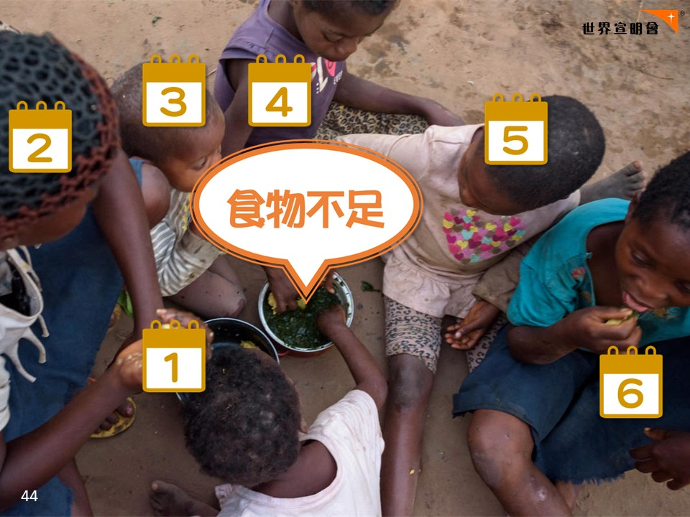
Notes:
-6個人
-原來瑪莉有5個弟弟妹妹, 連同瑪莉6個人
-6個人去分，根本唔足夠，所以佢地成日都要挨餓

Slide 45
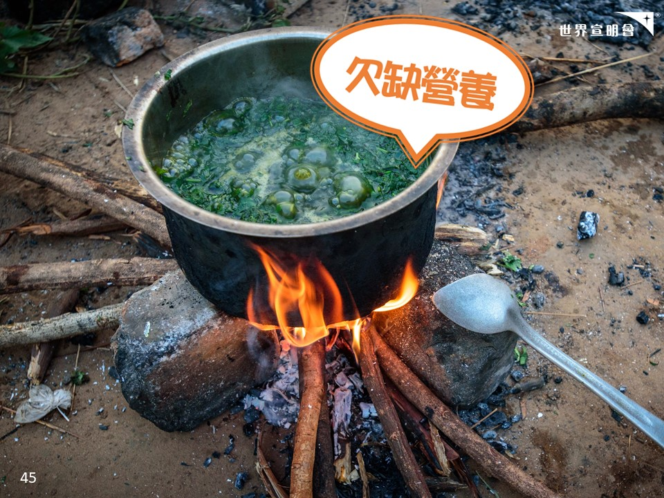
Notes:
-有冇人記得依盆係咩黎架？係蕃薯葉
-係佢地一家全日唯一的食物
-冇調味料唔單只唔好味，淨係食蕃薯葉你地覺得夠唔夠營養？唔夠
-不過瑪莉一家都好珍惜ED食物，喺佢地心目中，蕃薯葉係好重要，就係佢地嘅主角
-好似頭先第2個回合旱災咁，大地餐廳得菜同粟米，客人都冇嫌棄，都好珍惜

Slide 46
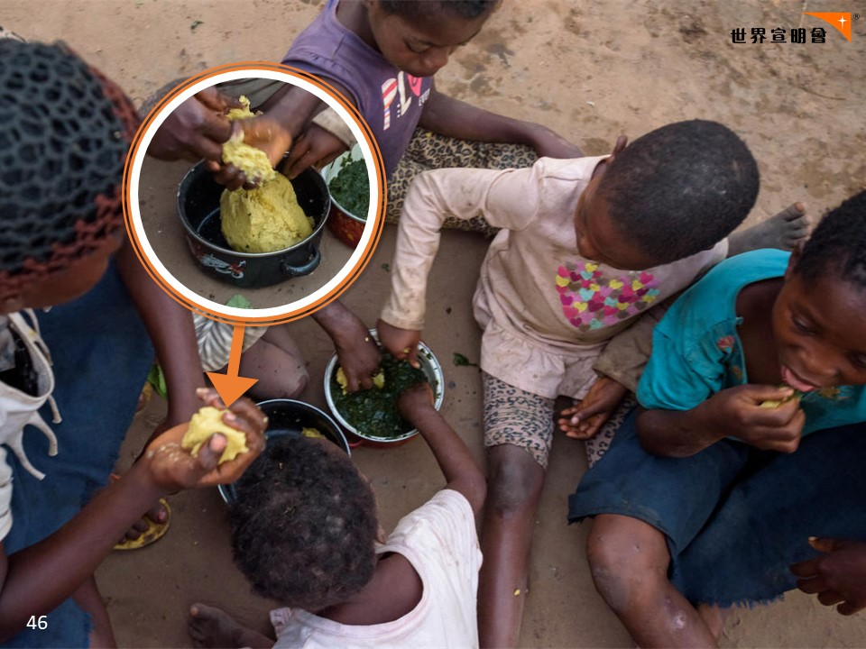
Notes:
-有時候佢地嘅鄰居同親人見倒佢地嘅情況，都會主動幫助瑪莉一家，分享了一些FuFu比佢地，即係黃色果一碗喇
-你地知唔知係用咩做架？ 粟米+木薯
-木薯即係類似我地食嘅薯仔

Slide 47
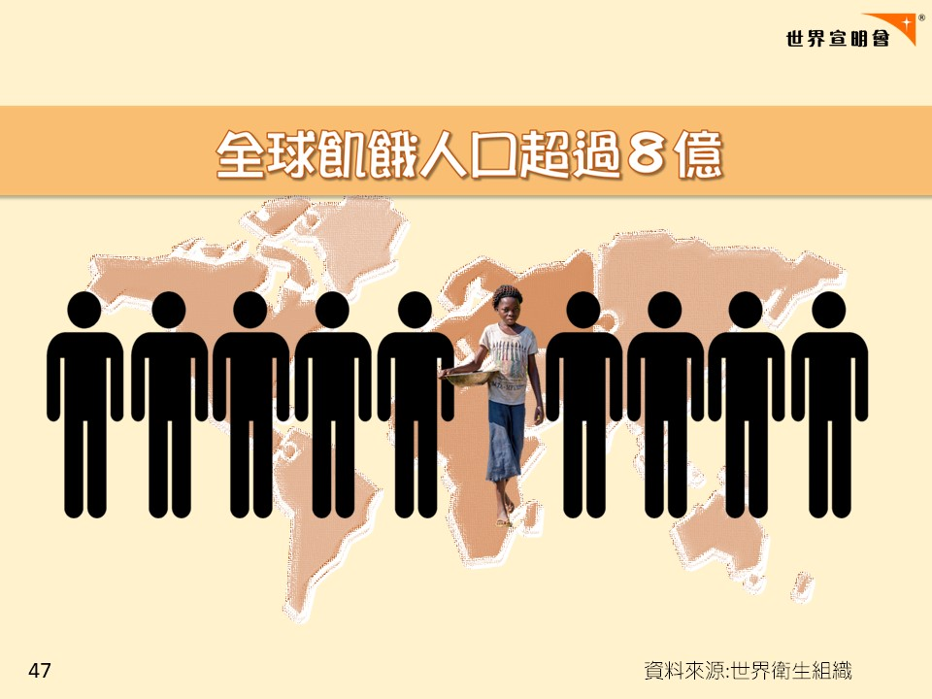
Notes:
-咁究竟點解瑪莉佢地要挨餓？
-世上有超過8億人好似瑪莉/大地餐廳嘅人一樣唔夠野食要挨餓
-即係10個人中就有1個好似瑪莉咁冇足夠既食物
-人類每日所生產嘅食物，明明足夠餵飽地球上所有人。
-究竟點解仲有人要挨餓架？
-------------------------------------------------------------------------------------
WHO [6 July 2022]: UN Report: Global hunger numbers rose to as many as 828 million in 2021
https://www.who.int/news/item/06-07-2022-un-report--global-hunger-numbers-rose-to-as-many-as-828-million-in-2021

Slide 48
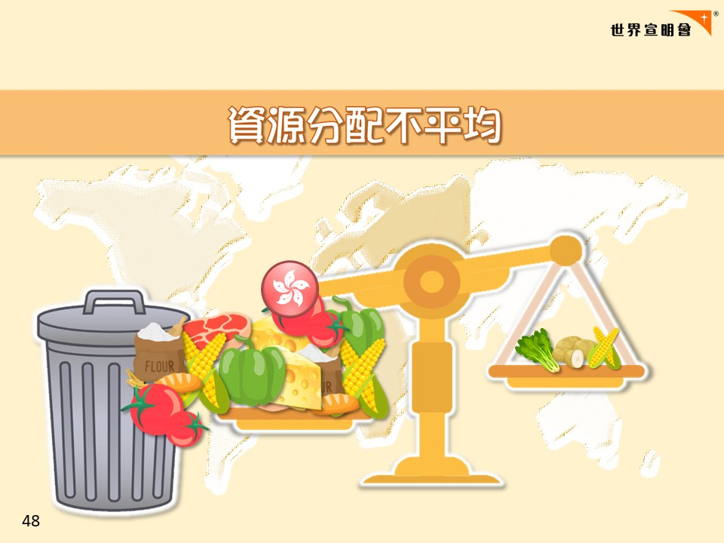
Notes:
-因為地球資料分配不平均
-有D地方好似豐盛餐廳咁，有較多資源，有好多唔同種類嘅食材eg. HK
-亦有D地方好似大地餐廳咁只有好少資源，令有些人沒有足夠糧食要挨餓；而且食材較單一，吸收唔夠營養
-可惜有較多資源嘅人，好似第3回合咁，好多時有食淨野同偏食習慣，浪費左好多食物
---------------------------------------------------------------------------------------------
世界糧食計劃署：2019 Hunger Map
https://www.wfp.org/publications/2019-hunger-map

Slide 49
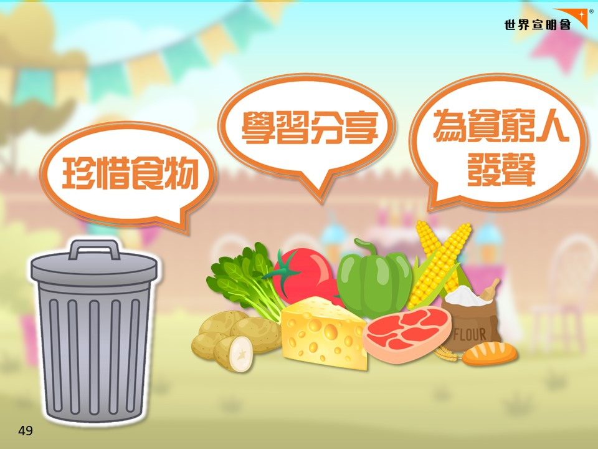
Notes:
-資源分配唔平均下，我地又可以做D咩？(問同學)
-第一個辦法就係珍惜食物
-其實所有食物都係主角，係好重要。我地要學習瑪莉，就算蕃薯葉唔好食，唔鐘意食都要盡量食，唔食淨野，唔偏食
-第2個方法就係同人分享
-我地可以學習瑪莉嘅親人/鄰居，同有需要嘅人分享自己擁有嘅物資/食物
-第3個方法就係為貧窮人發聲
-我地可以將瑪莉嘅故事，今日玩遊戲/食貧富餐嘅感受話比身邊嘅人知，等更多人認識貧窮人嘅需要

Slide 50


Slide 51

Notes:
[Reference]
資源：多/ 少
食物種類：多/ 少
營養：夠/ 不夠
替代品：有/ 沒有
>>>資源分配不平均<<<

