Slide 1


Slide 2
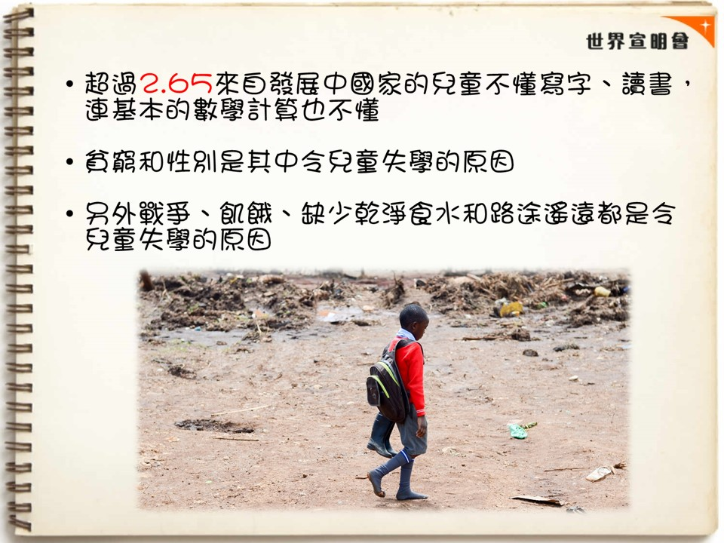

Slide 3
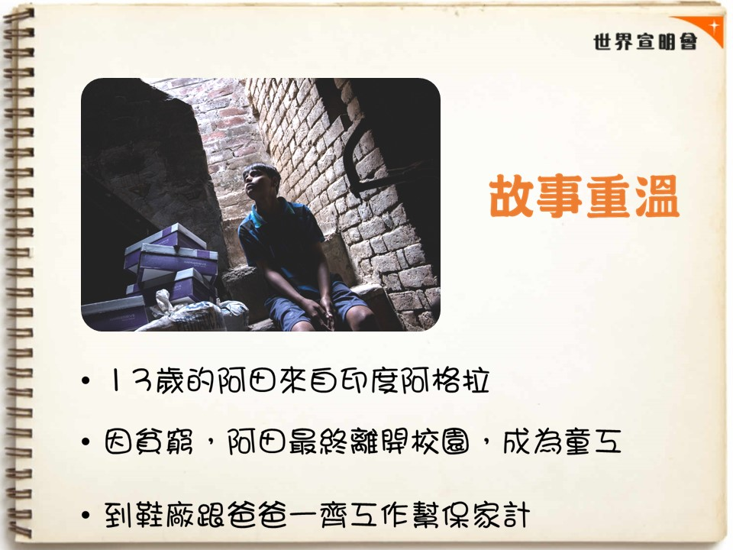

Slide 4


Slide 5
影片
《從工廠走進校園的拉法》(上)
https://www.youtube.com/watch?v=aihgoAJMyek&list=PLeY_z4fw8p7K24cMZvj9M2KjmfLJ-9XRh&index=11
《從工廠走進校園的拉法》(下)
https://www.youtube.com/watch?v=QqZ87qO-2uo&list=PLeY_z4fw8p7K24cMZvj9M2KjmfLJ-9XRh&index=10

Slide 6
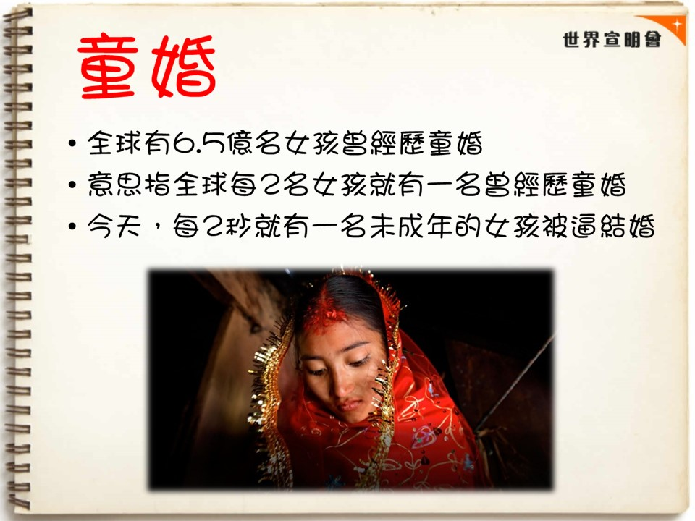

Slide 7
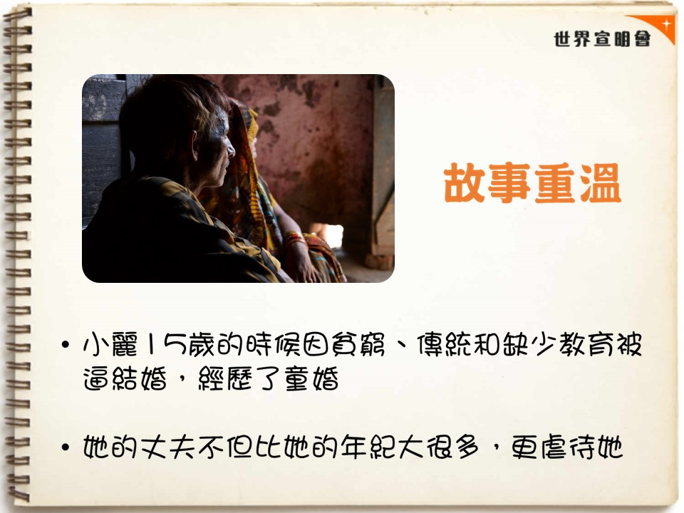

Slide 8
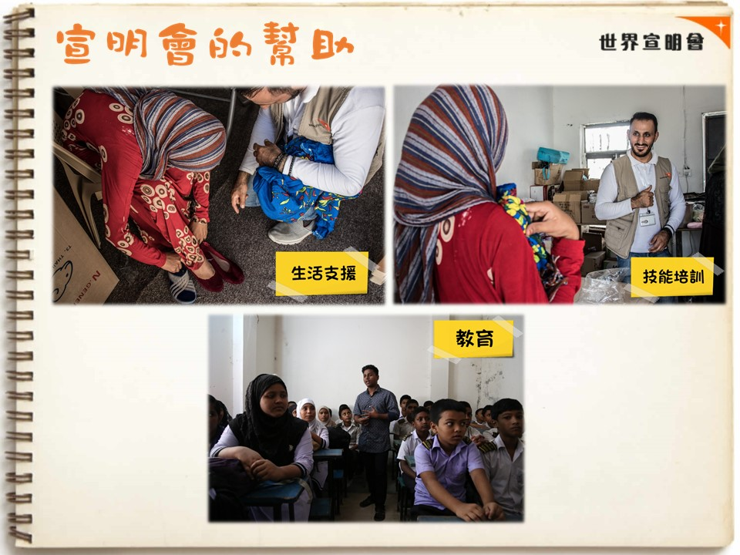

Slide 9
影片
【翠如走進孟加拉】之談婚論嫁
https://www.youtube.com/watch?v=i-XT2OqYDwA&t=22s

Slide 10


Slide 11


Slide 12
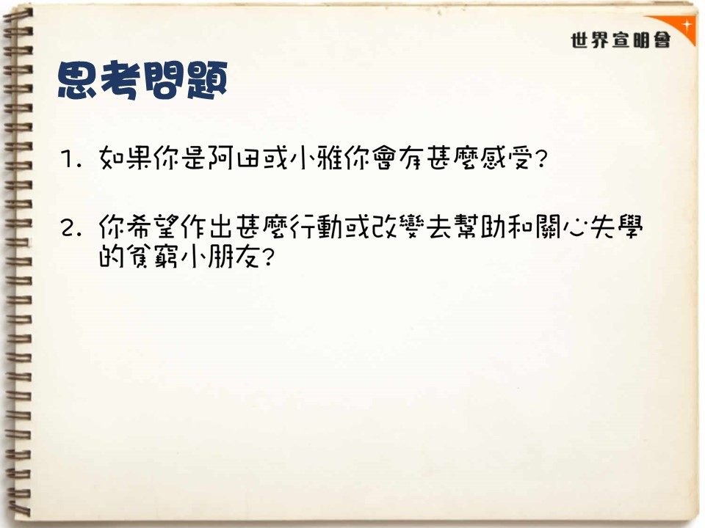

Slide 13
